Slide 1
RythymWare
A Progress Report On Our Rhythm Game Project

Slide 2
Introduction
Team Members:
Roman Brancato
Ethan Grant
David Geisel
Brian Turmbo

Slide 3
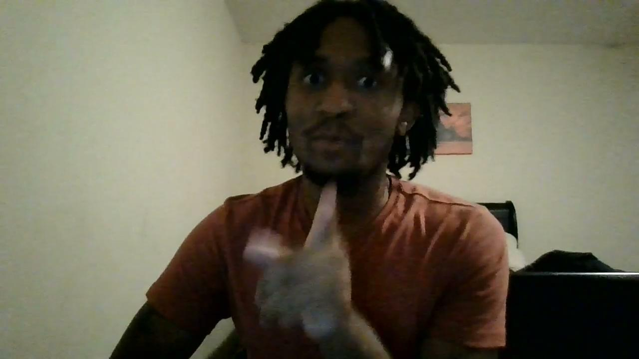
Brian Turmbo
Notes:
LINK TO VIDEO IF IT DOESN”T LOAD: https://drive.google.com/file/d/1GbnTRnETmfz38Q2wma09tmevQnh6x9VE/view?usp=sharing

Slide 4
Explanation of Our Project
A vertical scrolling rhythm game
Players will have to click “notes” falling from the top of the screen across 4 possible “lanes”
The notes are arranged and appear to reflect the rhythm of a song
Players must time their clicks accordingly when the notes reach a threshold towards the bottom of the screen in order to gain score
Miss timing will affect accuracy and missing will break accumulated combo

Slide 5
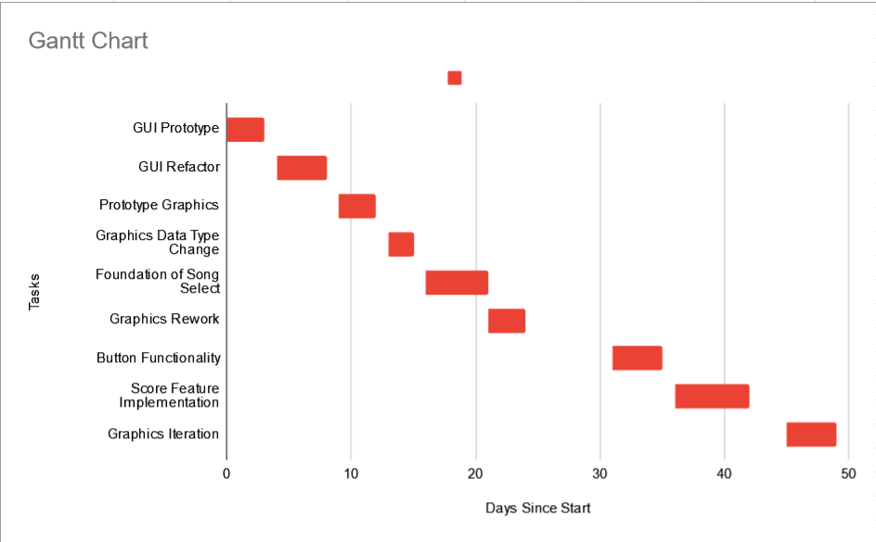
Gantt Chart
Notes:
Each person can explain what a tasks entails

Slide 6

Graphics Iteration
Notes:
LINK TO THE VIDEO IF IT DOESN”T LOAD: https://drive.google.com/file/d/1tu6E1V-aj_1y6BZHmKryvNINLIHhYH4a/view?usp=sharing

Slide 7
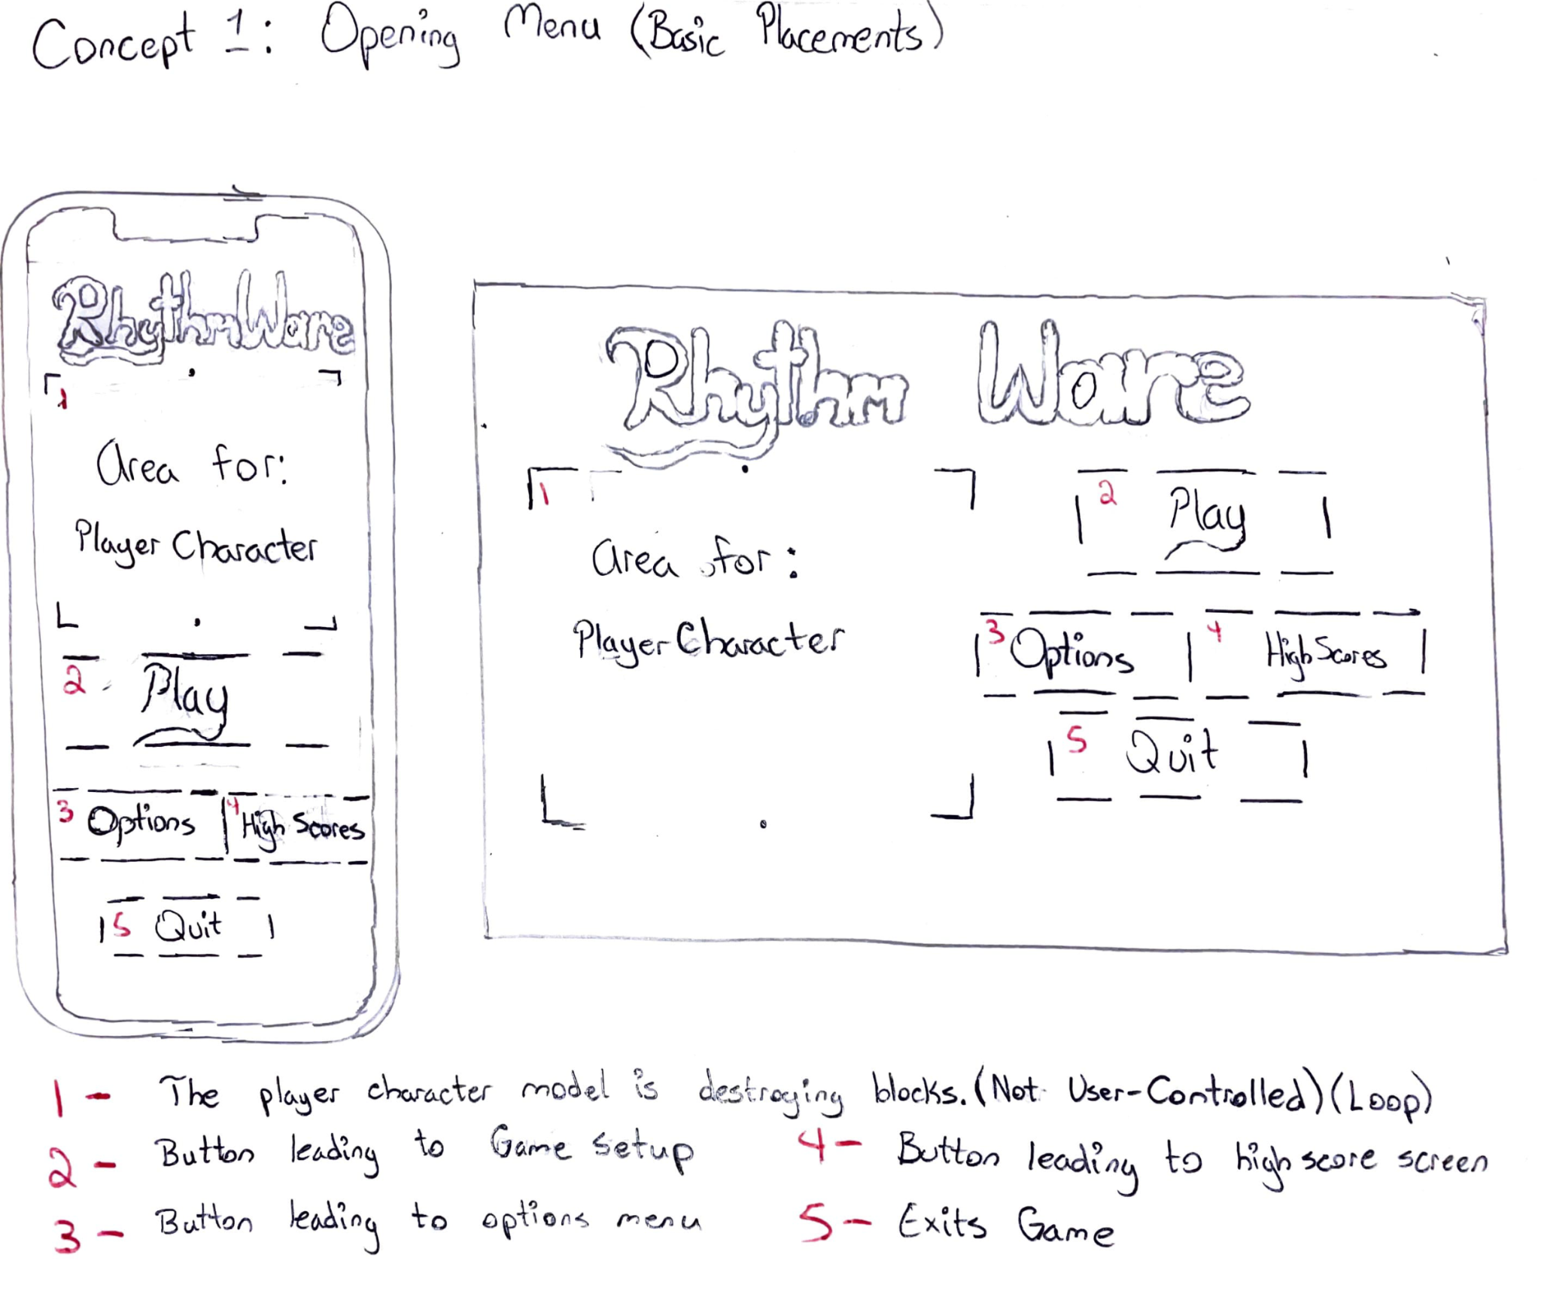
Some Mockups for GUI Designs

Slide 8
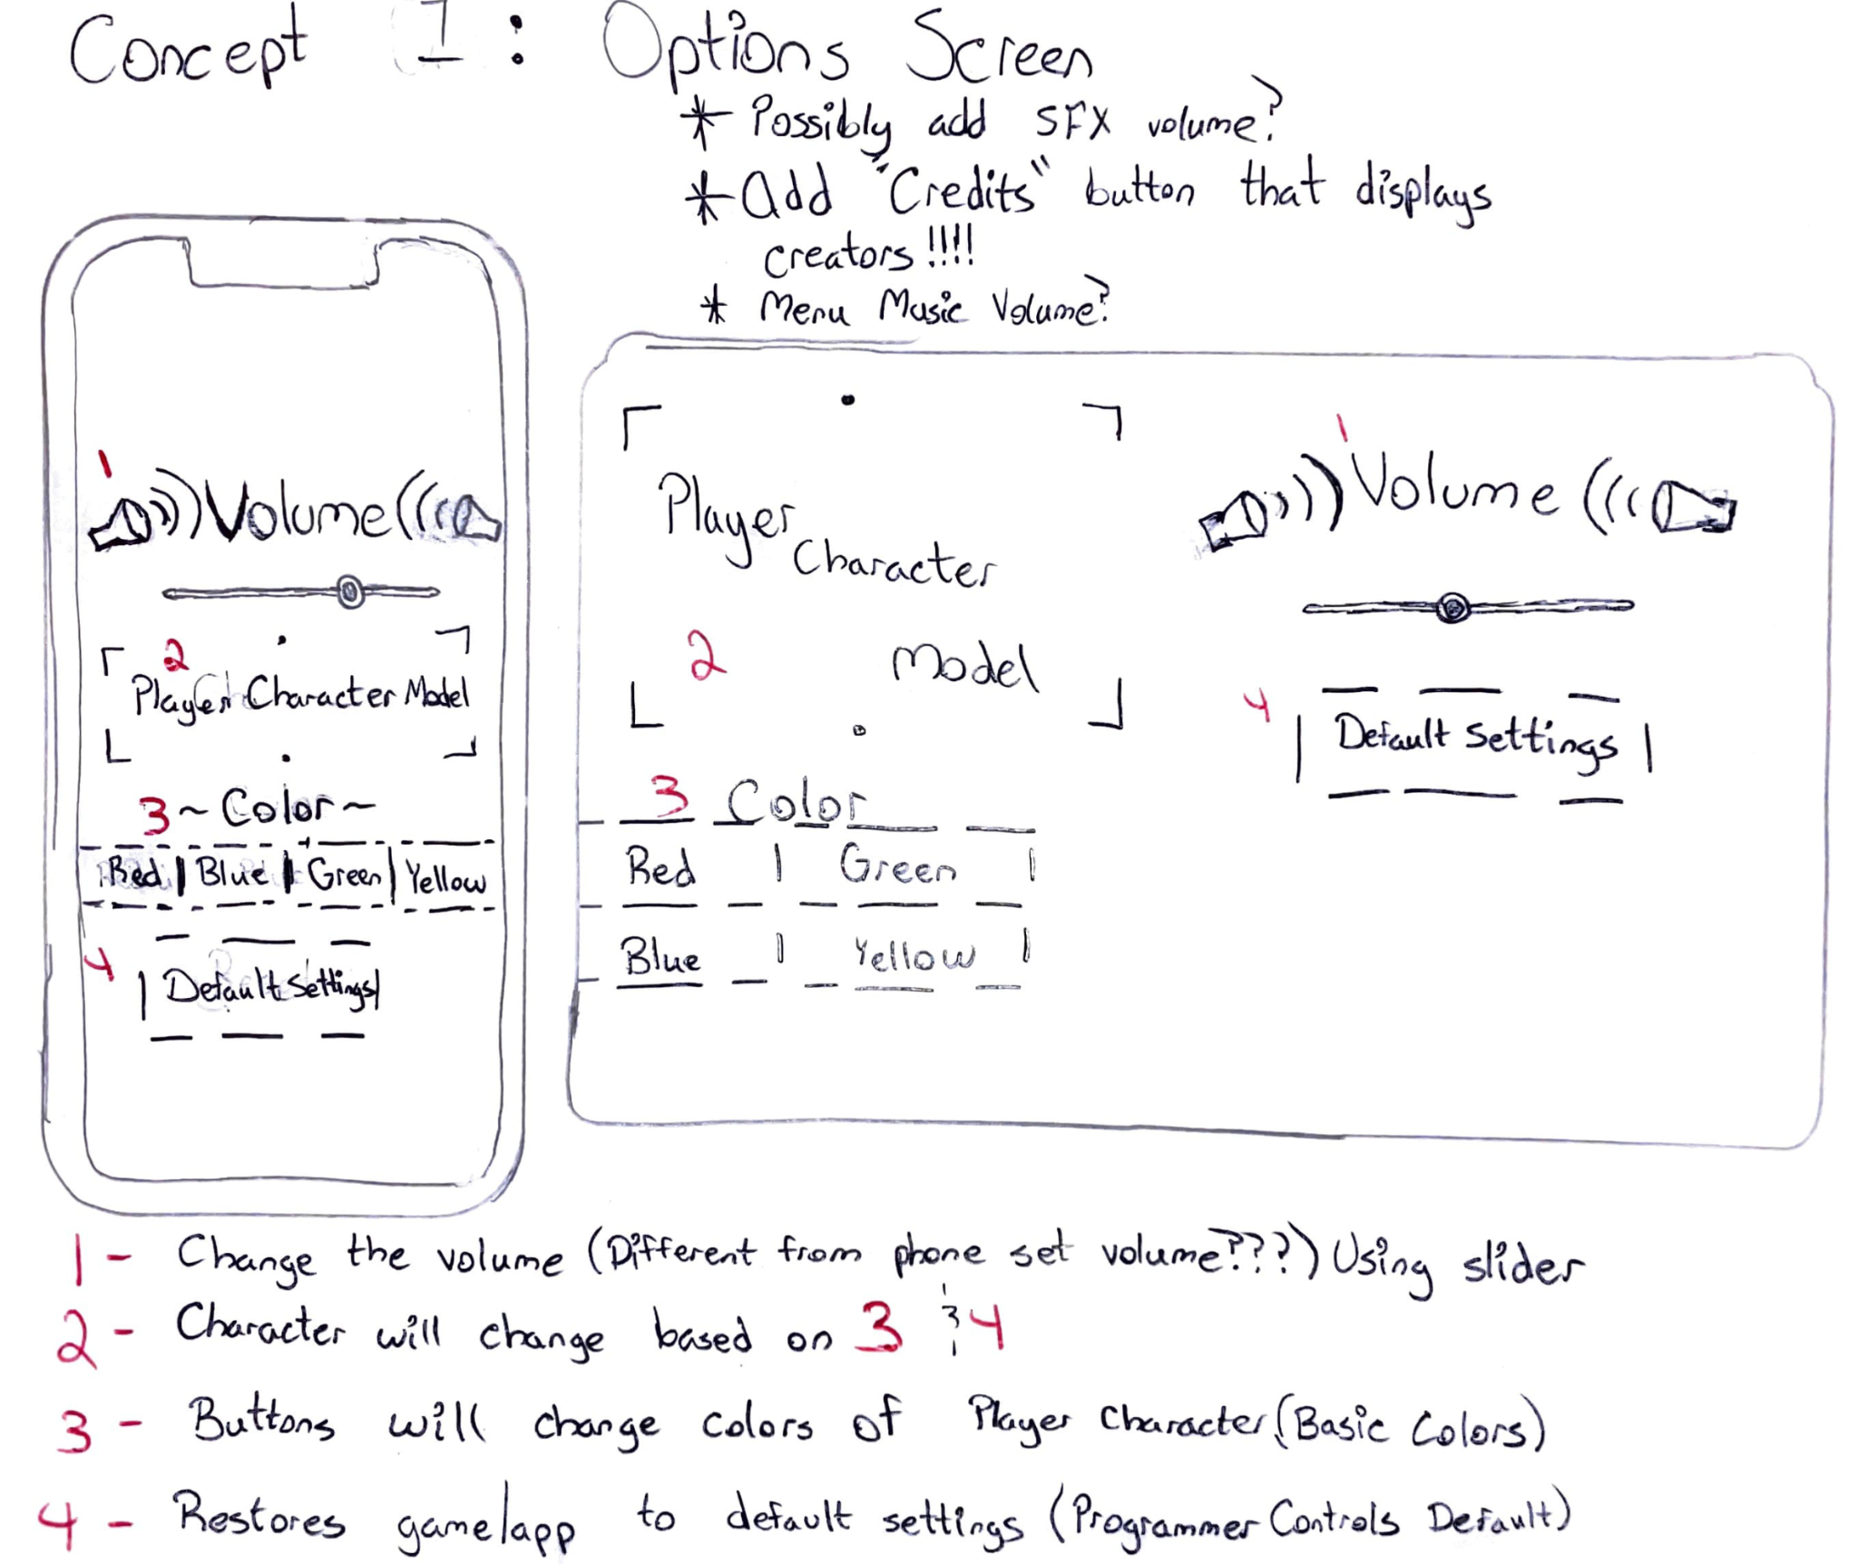
Some Mockups for GUI Designs

Slide 9
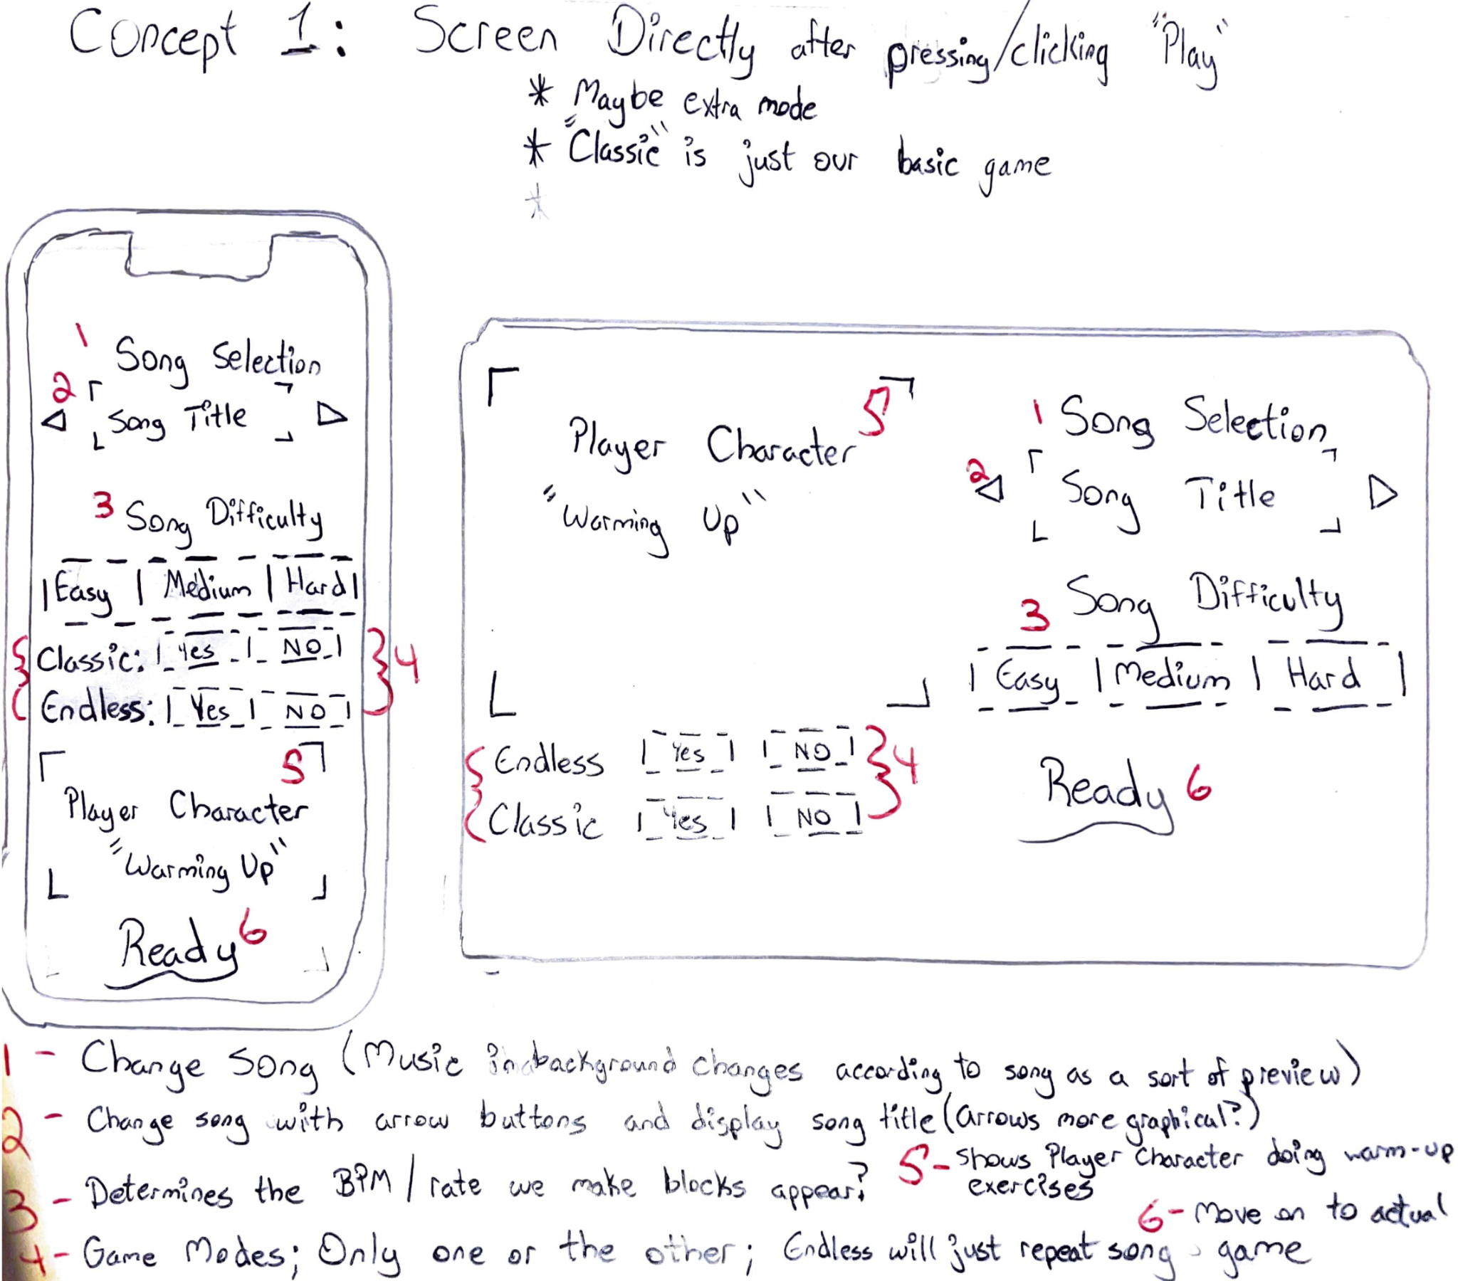
Some Mockups for GUI Designs

Slide 10
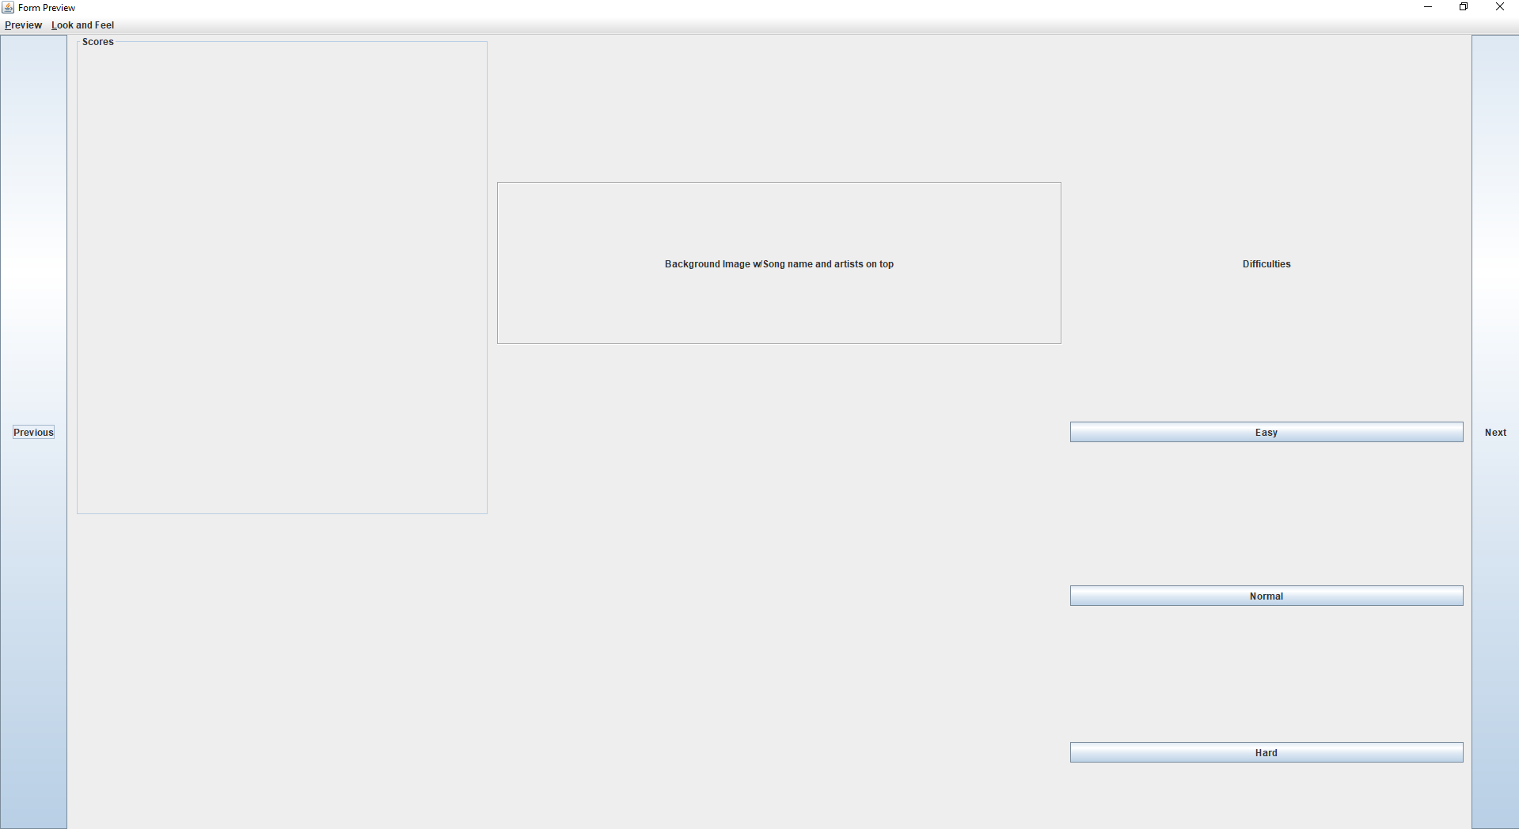
Song Select Menu Prototype

